Slide 1


MERN STACK PROJECT
Hackathon Presentation
Medi Point
Doctor Appointment Booking System
“Find the right doctor, at the right time.”
TEAM MEMBERS
HACKATHON
RAM CHARAM KARTHIK : 25MVCSMR0532
LOKESH : 25MVCSMR0484
VAMSHI : 25MVCSMR0466
SRIKANTH : 25MVCSMR0487
Hackathon 2026

Slide 2
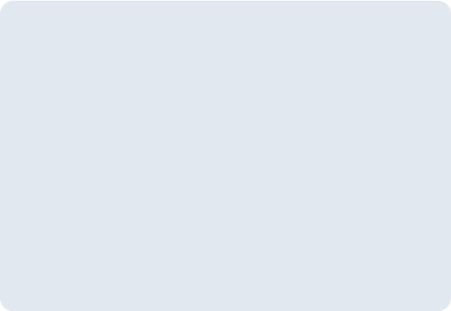

Problem We Identified
CuraPoint
Finding the right doctor can take time
Patients may have to wait in queues
Manual booking can cause confusion
Doctor availability is difficult to track

Slide 3
Our Solution
mediPoint
Search doctors easily
Connected Ecosystem
Check specialization & availability
Patient
Select preferred date and time
MediPoint
Book an appointment online
Doctor
Manage appointments in one place

Slide 4



How It Works
CuraPoint
1
2
3
4
5
Search Doctor
Choose Doctor
Select Date & Time
Book Appointment
Get Confirmation

Slide 5



Key Features
CuraPoint
Doctor Search
Easy Booking
Doctor Profiles
Filter by specialty & location
Instant slot confirmation
Experience & details
Time Slots
My Appointments
Secure Login
Real-time availability
View & track bookings
Protected user data

Slide 6





Technology Stack
CuraPoint
Frontend UI
Backend Server
NoSQL Database
Authentication
Communication
React.js
Node + Express
MongoDB
JWT
REST API
SYSTEM ARCHITECTURE
Frontend (React)
Backend (Express / Node)
Database (MongoDB)

Slide 7
Data Management
CuraPoint
Patient Entity
Doctor Entity
Appointment Entity
Create
Read
Update
Delete
MongoDB stores doctor, patient, and appointment information securely.

Slide 8
SUMMARY
Conclusion
Simple doctor discovery
Easy appointment booking
Better appointment management
Saves time for patients & doctors
“Medi Point makes doctor appointment booking simple, fast, and convenient.”
THANK YOU
Questions?

